Slide 1




Kindergartn System
Java project

Slide 2
Project idea
A kindergarten system software based on a SQL database with data of students , teachers .
For students, it takes their (first_name ,second_name ,Id , phone_number,Age,Address).
You can search for a student using his id number.
In the database the primary key is (student_id) .
For teachers, the project takes their personal data (name , salary , phone number , Address,subject,Age).
The primary key is (teacher_id) .
You can search for a teacher using his id number.

Slide 3
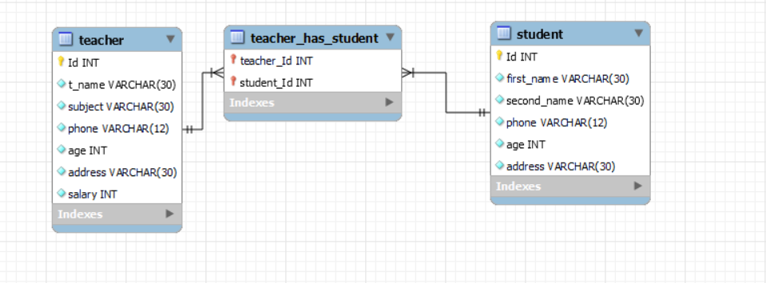
System erd

Slide 4

Home screen

Slide 5
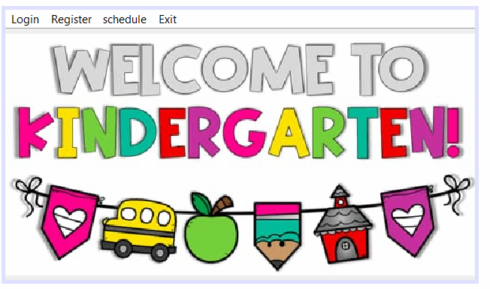
It is the opening frame.
In this frame you can go to any section you want in the program.
If you want to open the Login frame press on the panel “Login”.
If you enter the correct password you will go to “student” frame.
If you want to go “Teacher” frame press on button ”T_teacher” which on “student”frame.
If you want to open the Register frame press on the panel “Register”.
Or you can exit the program from exit button right below.

Slide 6
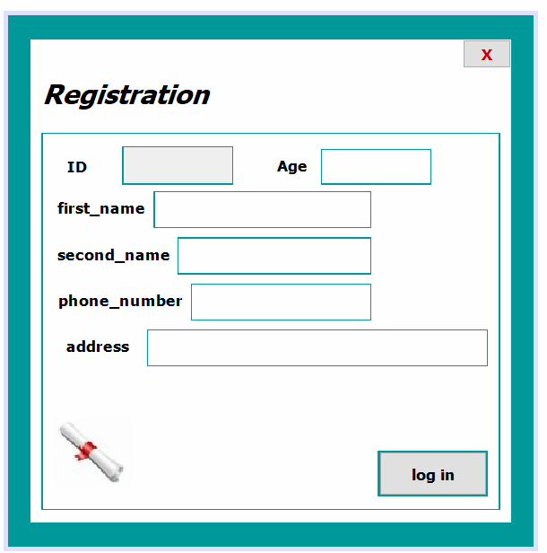
To add new student
Press “log in” button when you finish
Insertion of information.

Slide 7
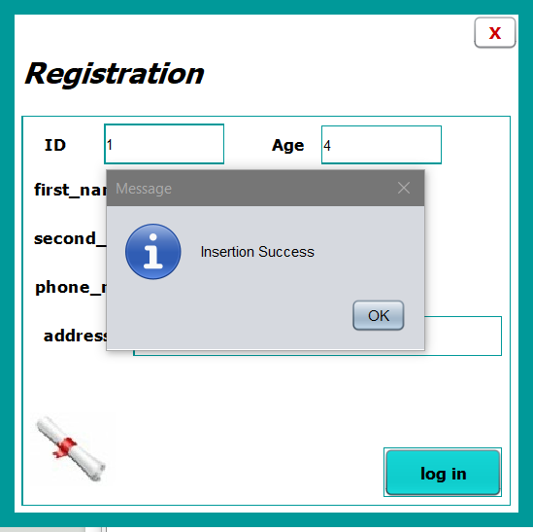
Register form:
When you press the button
A message will appear to show insertion success.

Slide 8
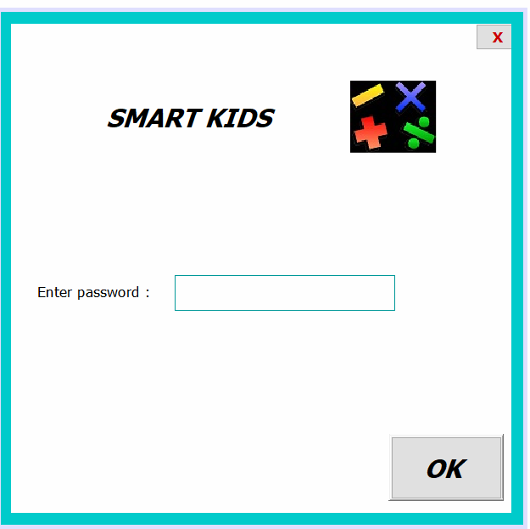
Log in frame

Slide 9
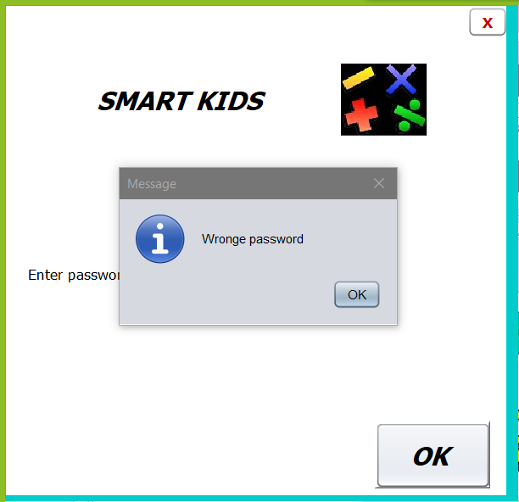
If you enter the wrong password:
A message will appear to show that the password is not correct.

Slide 10

Students

Slide 11
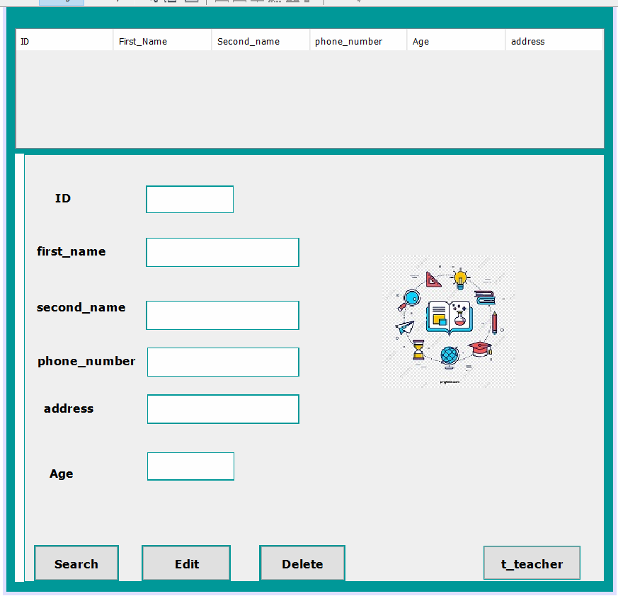
Student
If you enter correct password:
Here you can edit ,Search or delete his data
Student’s data is (id , first_name , second_name ,phone_number, address,Age).
It contains a place where you can search for a student using id .
You can go to Teacher frame by pressing on “t_teacher” button.

Slide 12
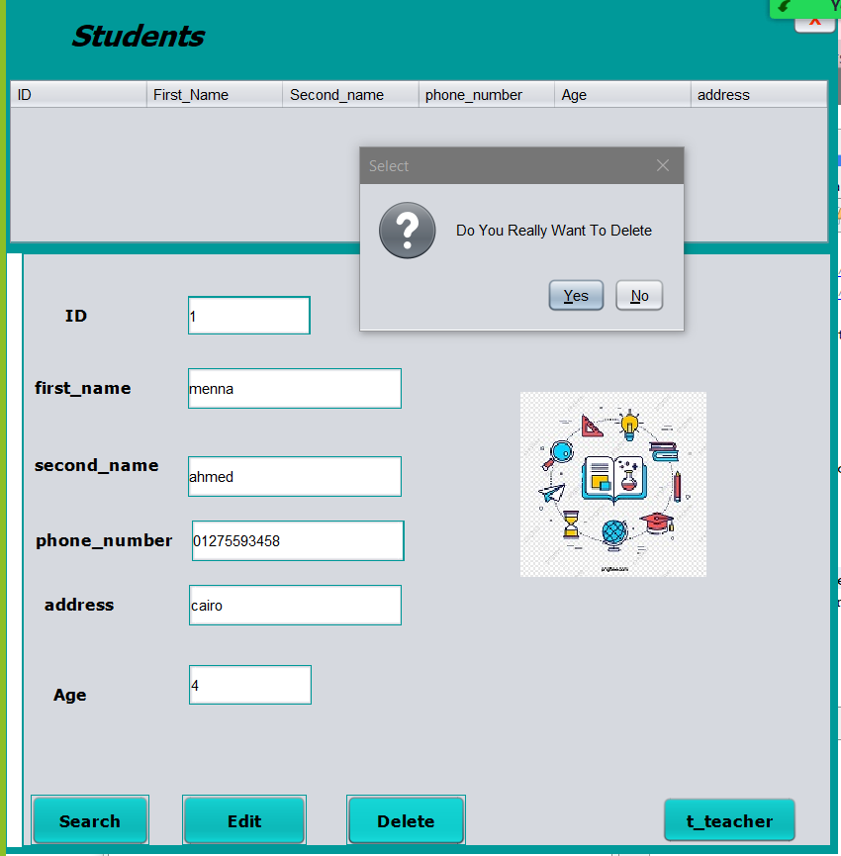
To delete student information:
Delete
you had to write id of student you want to delete
Then press “Delete” button.
A message will appear to ensure if you want to delete or not

Slide 13
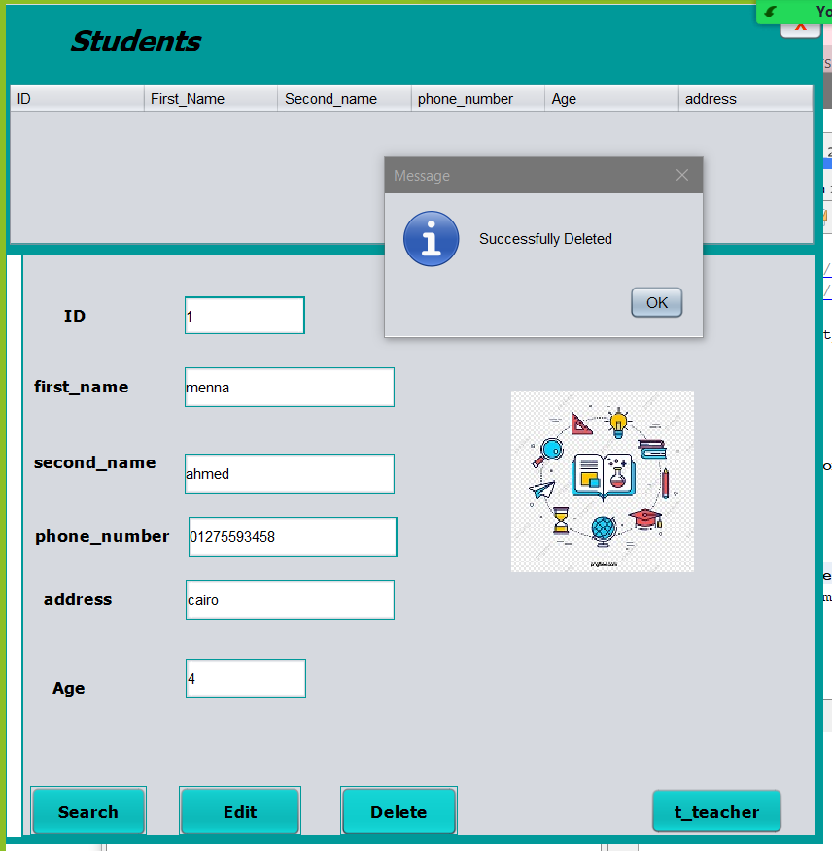
To delete student information:
. When you choose yes , a message appear to show”Sucessfuly Deleted”.

Slide 14
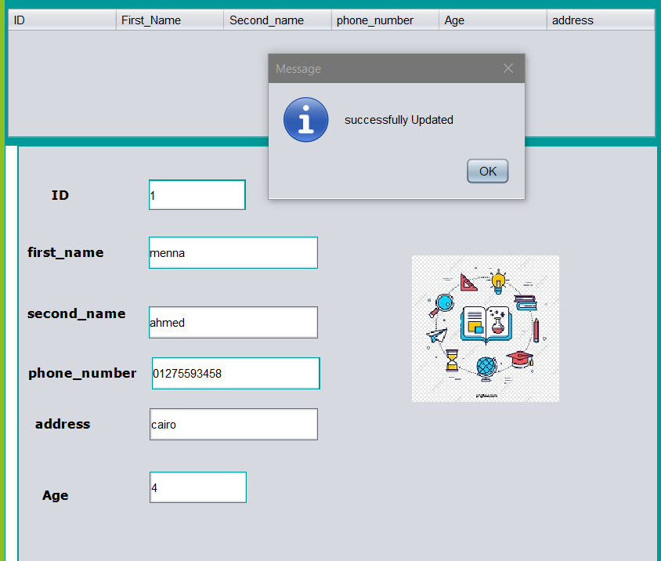
Edit
You enter the ID of student you want to update his information.
And change or update the information you want to update.
A message will appear to show that the Updated is done successfully.

Slide 15
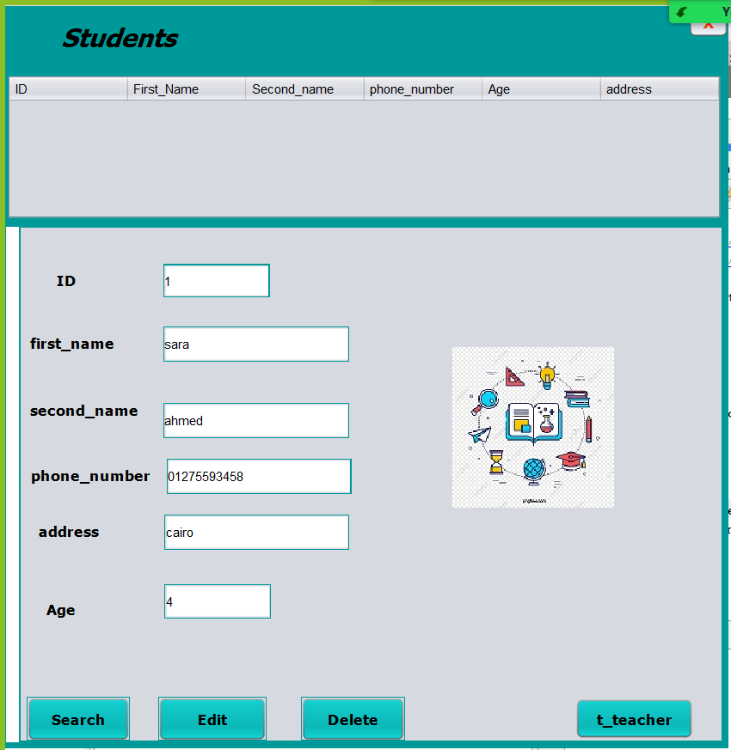
To search for student:
Search
By “Search” button you can get student information by his ID
The information will appear in the text boxes.

Slide 16
To go to teacher frame:
. By “t_teacher” button you can go to teacher frame

Slide 17

Teachers

Slide 18
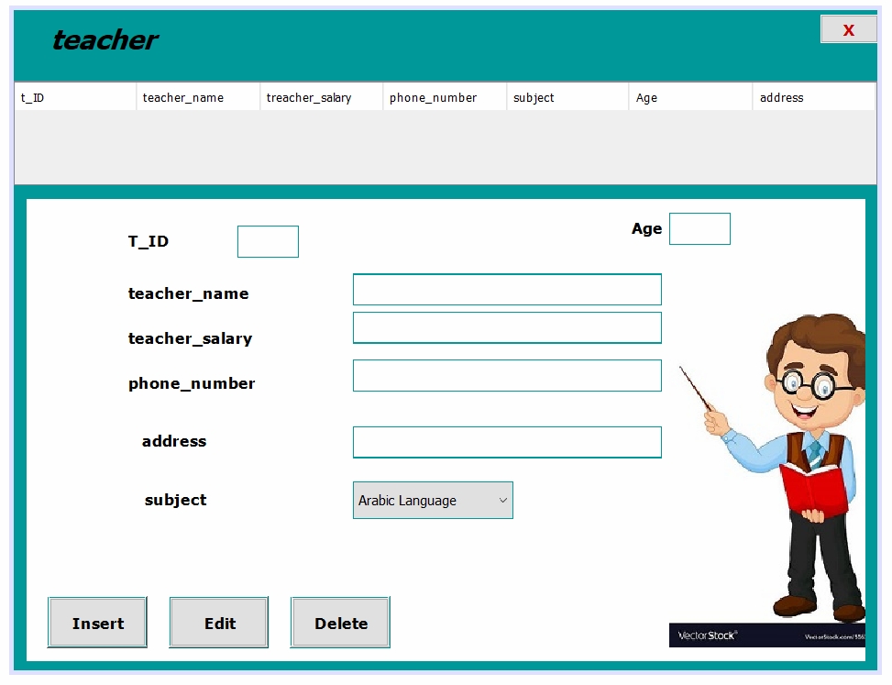
Teachers
Here you can insert to add a teacher , edit or delete his data
You can show all the teachers data.
Teacher’s data is (id,name,salary,age, phone number , address,subject).

Slide 19
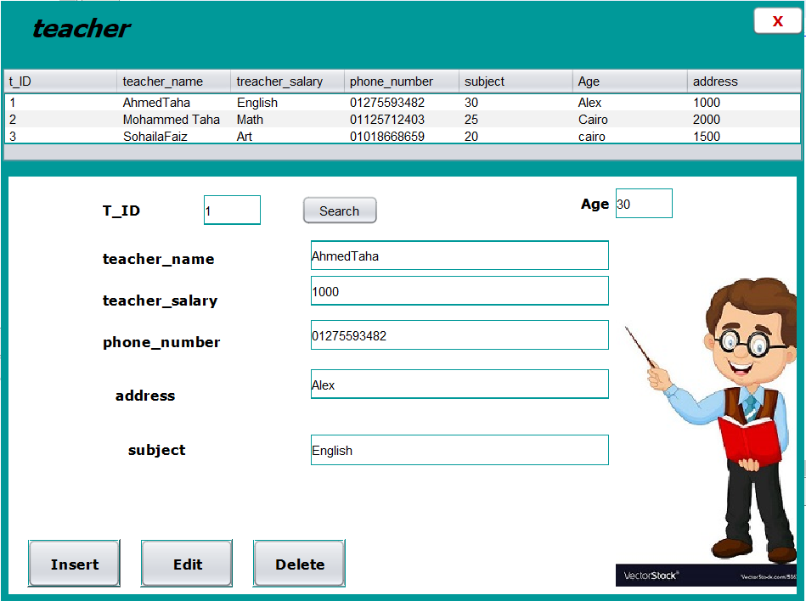
Search
You can search using ID.
Press on (Search) button.
The information will appear.

Slide 20
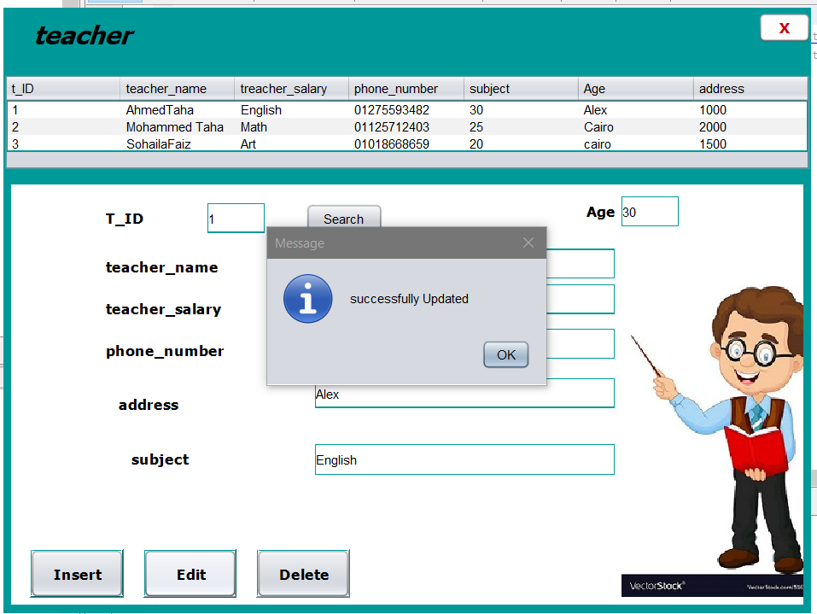
Edit
You enter the information you want to edit.
Press(Edit)button.
A message will appear “Successfully Updated”.

Slide 21
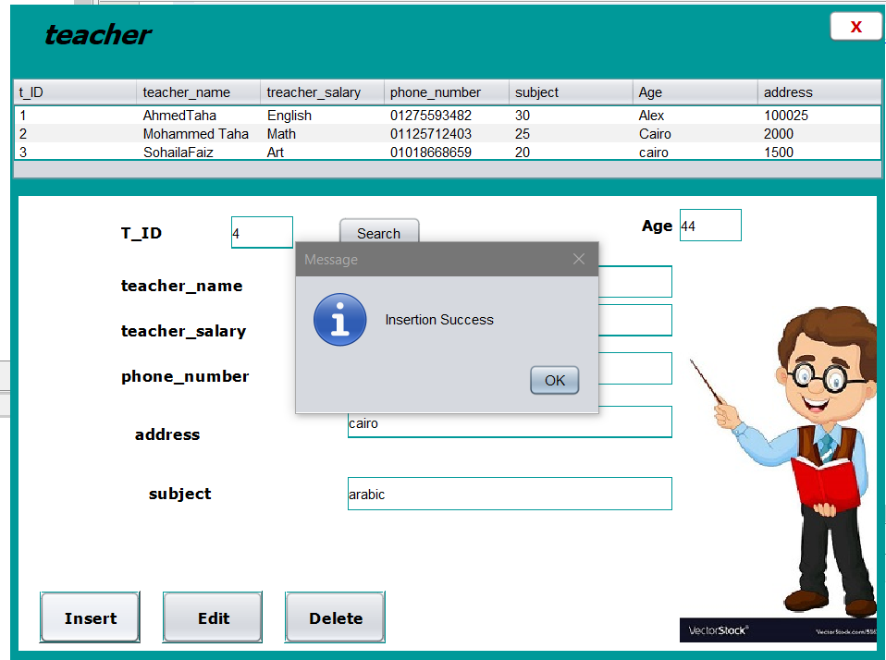
insert
To insert a new teacher:
You add the information and Id
Then press(Insert) button.
A message will appear “Insertion Success”.

Slide 22
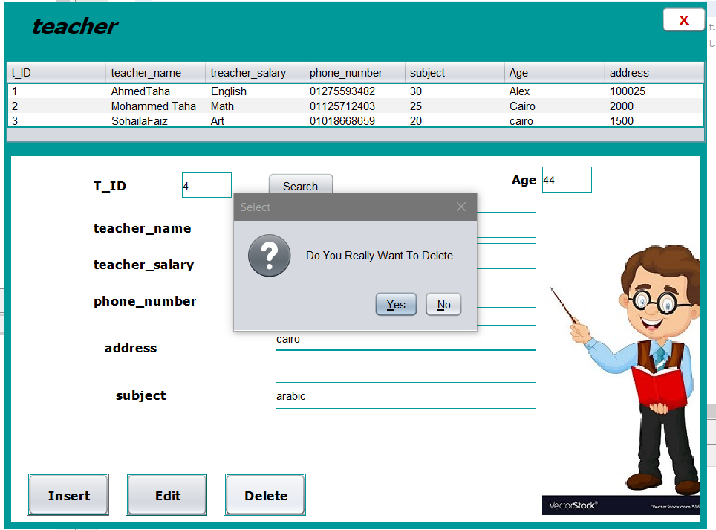
Delete
You first select the Id of teacher you want to delete.
Press (Delete) button.
A message will appear to ensure you want t delete.

Slide 23
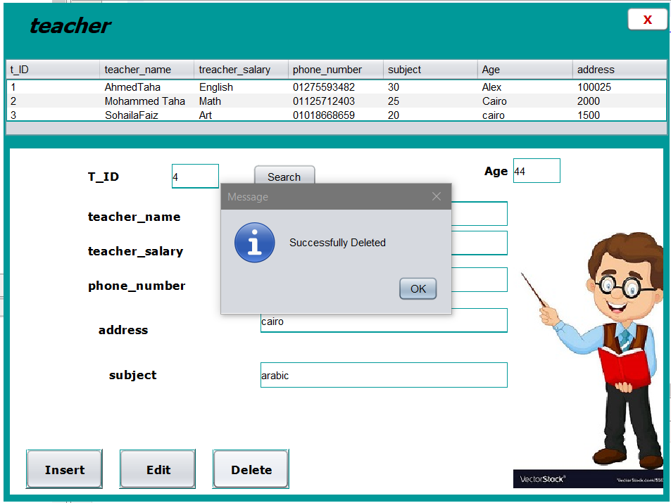
Delete
When you press “yes”.
A message will appear
“Successfully Deleted.

Slide 24

Thank you

